Slide 1

CS 225 Project Dungeon Crawl
Jaxson Mitchell
Zoe MOrAwek
Thomas Meyers

Slide 2
Overview

Slide 3

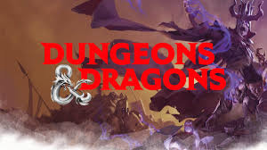

Overview: What is the project?
The goal of the project is to create a text-based campaign where
Four brave adventurers struggle to find the ever elusive salt-shaker!
The adventure was based off Dungeons and Dragons
Adventurers have multiple classes (Knight, Wizard, etc.)
There are multiple different types of enemies.

Slide 4
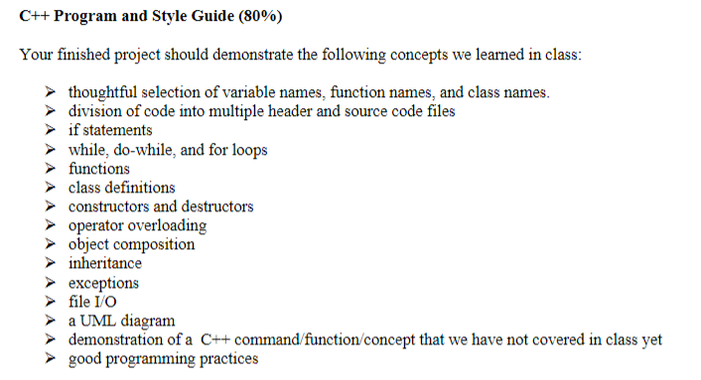
Overview: The rubric
The code must utilize the following within our project.

Slide 5
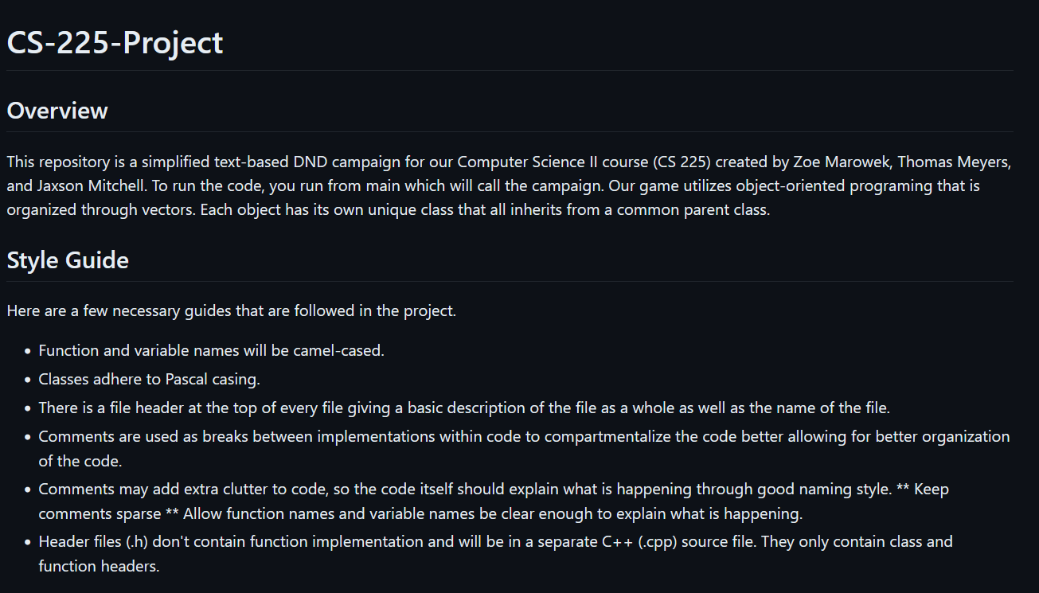
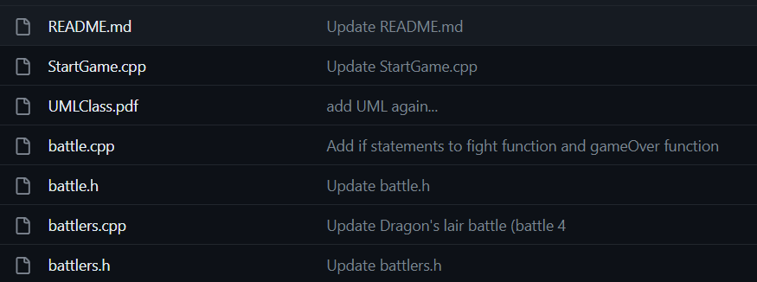
Overview: Repository and Style Guide
The code lives in the repository given by
https://github.com/JaxsonMitchell/CS-225-Project
We have a style guide in our project’s README
Camel casing for functions and variables.
Pascal Casing for class names
Comments
File headers
Breaks between sections.
Extraneous comments used for later reference
There are more rules for the style in the README

Slide 6
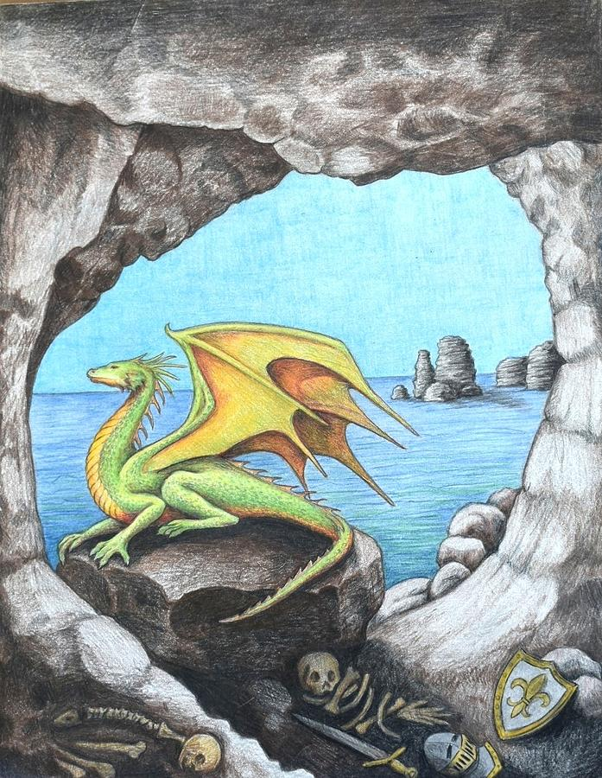
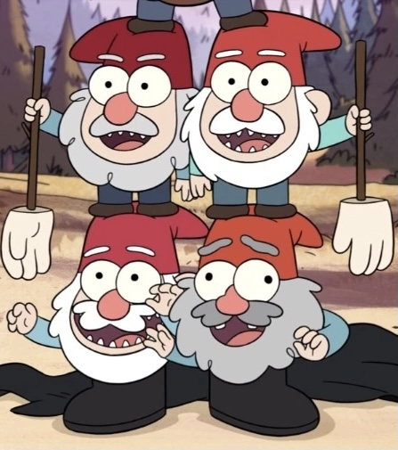

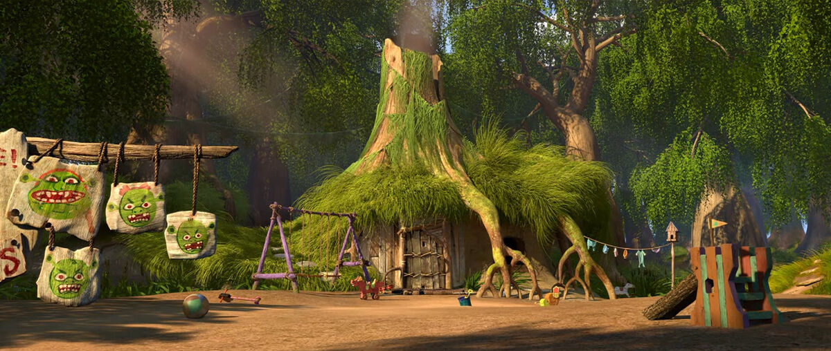
Overview: Our Game
There are four battles the adventurers must fight through, each of which with different enemies.
Gnome York
The Circus
The Swamp
Dragon’s Lair

Slide 7
Implementation and Diagrams

Slide 8
Class Diagram
The UML diagram can be classified into three major sections:
Adventurers
Monsters
Battle

Slide 9
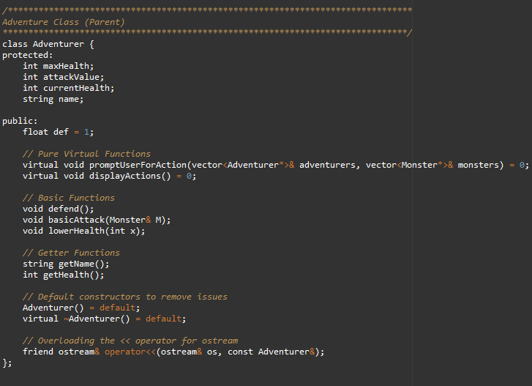
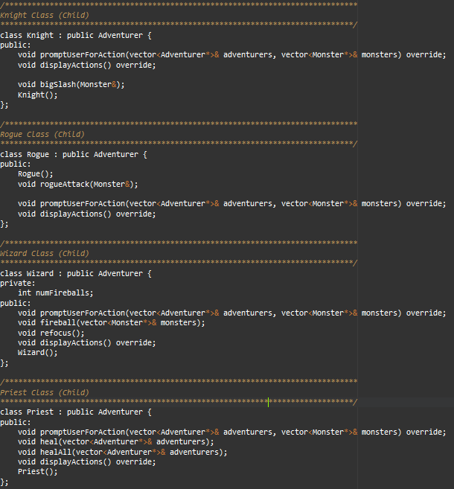

Implementation: Adventurer Classes
These Adventurers contain the following classes:
Abstract Base Class (Adventurer)
Knight Class
Wizard Class
Rogue Class
Priest Class
Operator Overloading the insertion operator

Slide 10
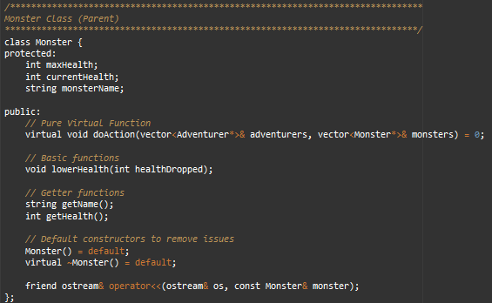
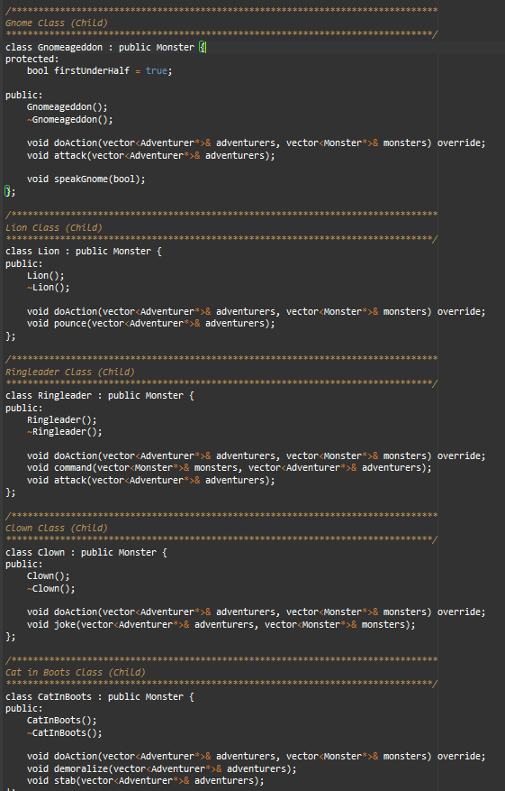

Implementation: Monster Classes
There are many monster classes, but it has a similar structure to adventurers
Abstract Base Class (Monster)
Gnomeageddon Class
Lion Class
Ringleader Class
Clown Class
NondescriptOgre Class
CatInBoots Class
Jackass Class
Dragon Class
Operator Overloading insertion Operator

Slide 11
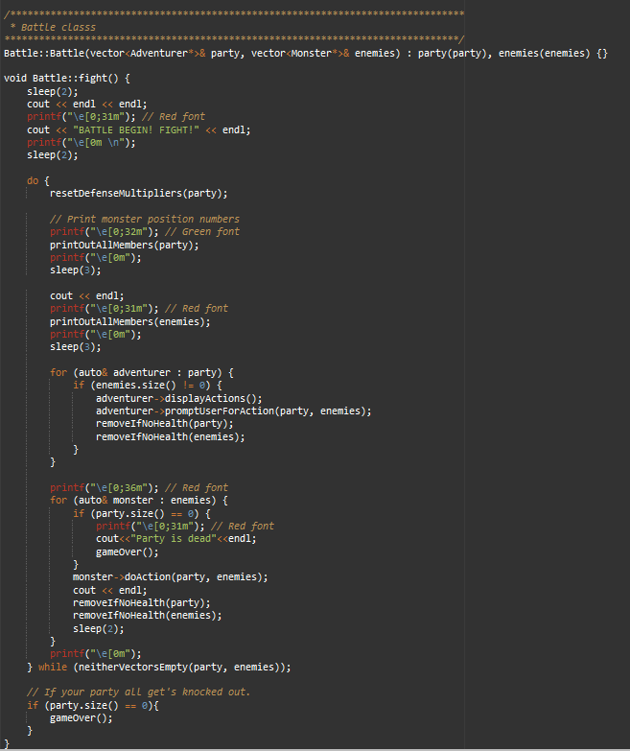
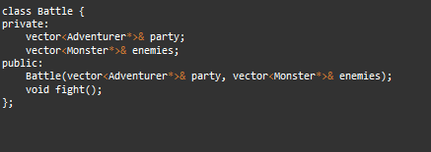
Implementation: Battle Class
The Battle class allows for an object oriented approach of having adventurers and monsters battle.
Object Composition is used to store the party and enemies
References are used to ensure when a member gets knocked out, they aren’t revived for later fights.
Pointers are used to allow for polymorphism
Abstract Functions: doAction, promptUserForAction

Slide 12
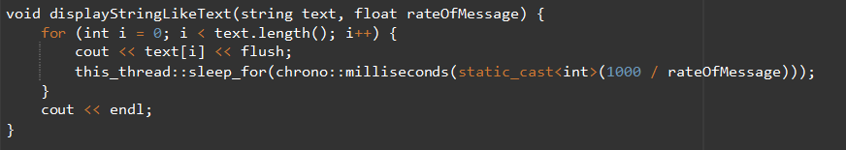
New C++ Concept
Our new function allows for speech of user and monsters to be typed out at specific rates.
Used within the function displayStringLikeText
Inputs include text, and the rate of text outputted.
The function utilizes threading
A thread reads the script and has an order of functions to complete
Sleep_for within the code forces the thread to stop for a moment simulating a specified text speed.

Slide 13
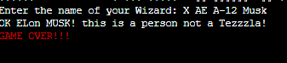
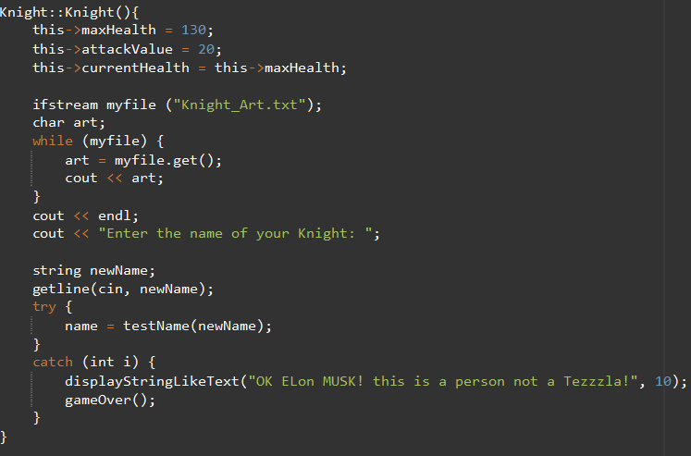
Exceptions
Exception handling was utilized in the child classes of the adventurer.
It forces the adventurer’s name to not have any numbers within it.
Why should we have numbers, what are we… Elon Musk??
We can see below what happens if you name your dear adventurers with a number

Slide 14
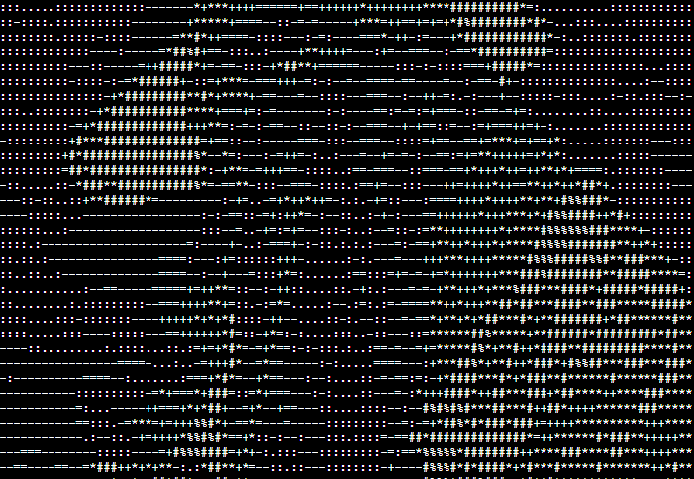
File I/O
Within the Constructors of the child classes of the Adventurer class, we also have file I/O
Art of the adventurer is displayed as you enter your name
Reading in ASCII art of the adventurers and displaying it to cout

Slide 15
Demo Time?
While it’s nice to talk about the code, I feel like it’s more fun to see it in practice.
Let’s play

Slide 16
DEMO TIME

